Slide 1

https://www.uni-goettingen.de/en/48115.html
Unless I explicitly state otherwise, images and cartoons are created using ChatGPT.
You may use this material free of charge under the terms of the CC BY license. This requires that you provide appropriate attribution to the author: W. Link, University of Goettingen, Germany.
In a few cases, individual images, photographs, or similar material may be subject to a more restrictive Creative Commons license. Where this applies, it is explicitly indicated, and you must comply with the stated license terms for those items.
Please check the license information carefully before reuse. Responsibility for complying with the applicable license terms rests entirely with you.
PopGen_Ch-6
Population Genetics; Selection
1

Slide 2
Sequential Number: #7
UNPLAB-PopGen_Ch-6[Selection]
2

Slide 3

3

Slide 4
We left the topic of Drift (Random Genetic Drift). We do not consider Drift in the next step although honestly this is clearly a wrong move.
We start to talk about Selection. We ‘select’, this means we choose better ones (as parents for future generations or as direct end-product); the less good ones are not taken. Yet, we describe this as if the number of selected ones was so large that Drift can be ignored. This is just to separate the Population Genetic effects of Drift from the effects of Selection.
But.
Bevor embarking into this topic, I have, being a German citizen, to invest an extra moment; to ponder the term ‚Selektion‘.
4

Slide 5
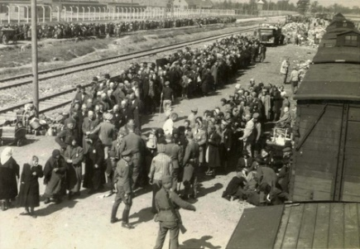
Queueing to be selected. People were separated in two groups: (1) work in concentration camps or (2) die in gas chamber.
Mind: This is a major meaning and connotation of the word ‘selection’.
Berlin
750km
Breslau
Göttingen
Leipzig
In later phases (1941 – 1945) of the so-called Third Reich, Nazi-Germany killed
a number of 5.7 to 6.3 millions Jewish citizens (in addition to Sinti, Roma and others).
Auschwitz in (occupied) Poland was a main place of the Holocaust (mass-extermination of people).
Other such places were Sobibor, Treblinka, Majdanek, Belzec.
Prague
Auschwitz
https://commons.wikimedia.org
Public Domain
5

Slide 6
6
Here, with focus on Plant Breeding and Applied Genetics, we focus on Selection to describe a natural (evolution) and human-made (domestication and breeding) phenomenon in plant species (and animals or fungi).
As soon as we have genetic diversity (genetic polymorphism) for a trait, say for flowering time; and if a specific level of expression of such trait is preferred (and trait differences are to some extent inherited) … if ‚we‘ or nature thus prefer say the earlier flowering plants, then we increase the frequency of acceleration-alleles and decrease the frequency of retardation-alleles.
The selected ones are the ones we take, the others are ‘culled’ or ‘discarded’ or not-selected. Whether the selected ones are perennial clones and used and propagated as such, or whether their sexual offspring is used ... in the first moment this is not relevant. The first step is just the selection: ‘take or don’t’.
The selected ones (plants, animals) are the ones that survive? Rarely (perhaps selected forest trees ‘survive’). Selected animals are usually also processed, used as meat, they also go to the slaughterhouse. Only later than the others, after they have been used for breeding (phenotyping, genotyping, offspring. Indeed, Lisa).

Slide 7
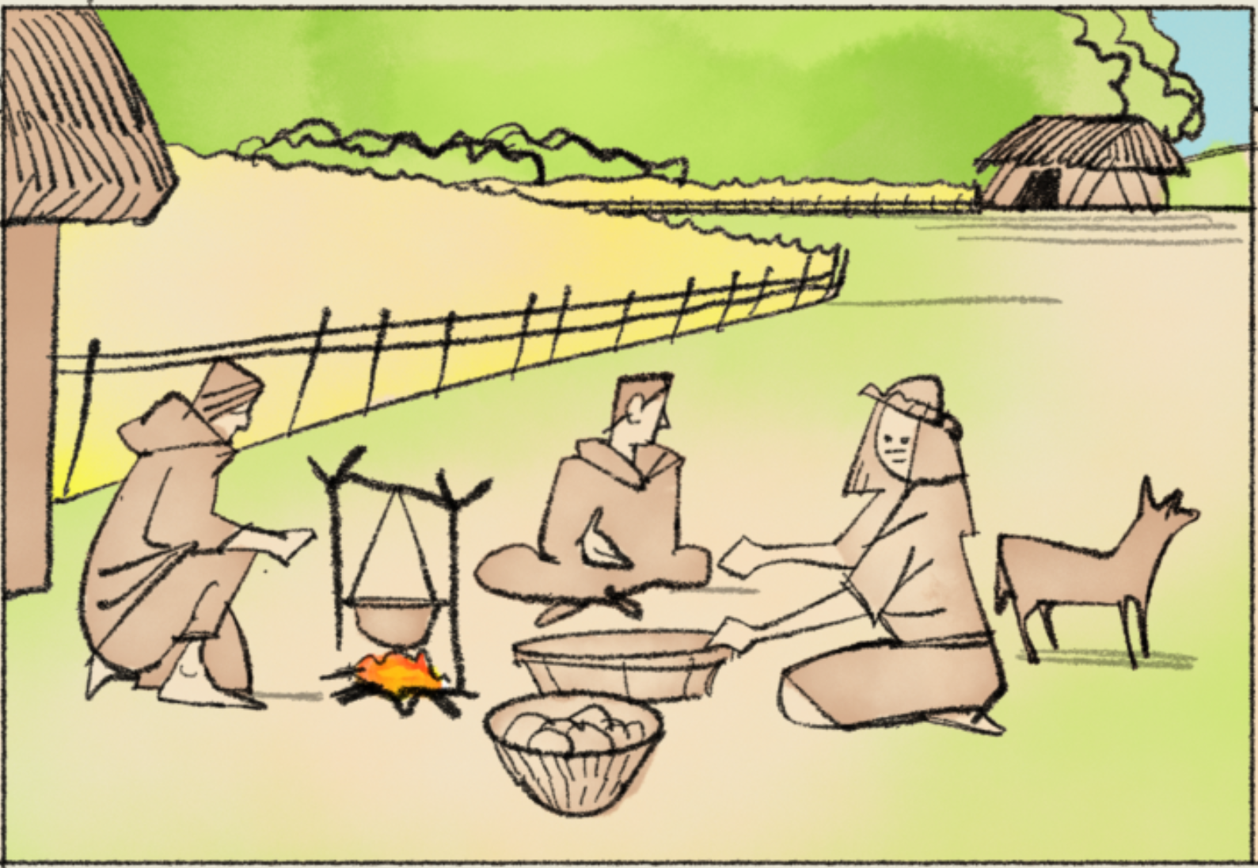
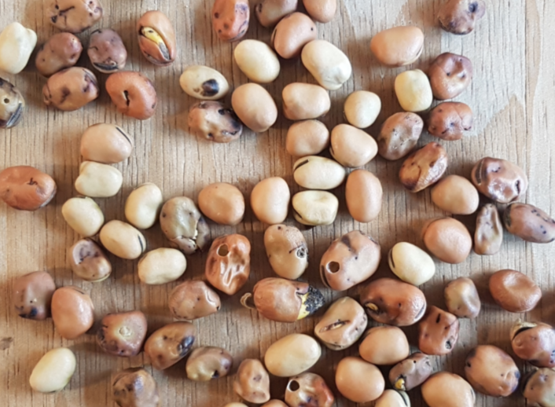
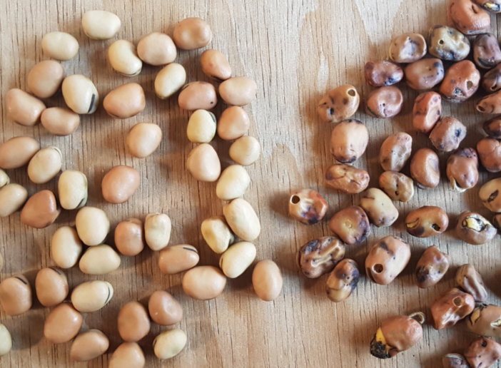
Selection. Probably in the first millenniums such selection was mainly female work.
Vöglein: Die Guten ins Töpfchen, die Schlechten ins Kröpfchen. Aschenputtel. Grimms Märchen.
Dear birds: The good ones go into the pot, the bad ones go into your goiter. Cinderella. Grimms’ fairy tales.
Surely a sample of the good ones was used for sowing the next season, while the bad ones were eaten by the helpers, by the birds.
© Henri Laugel
© SY
7
7

Slide 8
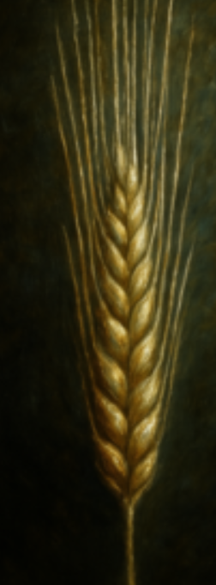
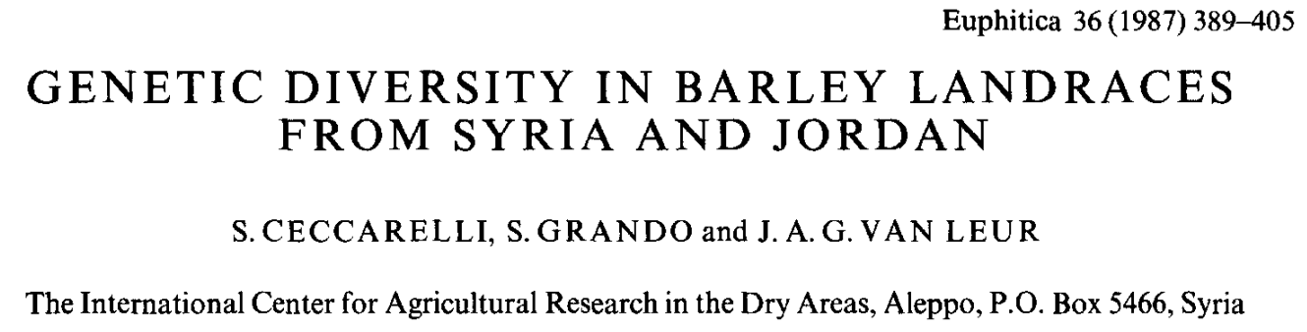
DOI 10.1007/BF00041482.
Most landraces that ‘live’ in textbooks are ‘Syrian barley landraces’; this is probably a side-effect of Salvatore Ceccarellis’ lifetime achievement in breeding research.
Such landrace of a self-fertilizing agricultural crop is a locally adapted and evolving population of ~endless many, genetically different yet homozygous plants that reproduce via self-fertilization. It is a highly homozygous and highly heterogeneous crop stand. It is to some extent similar to a multi-line cultivar or to a bulk in high inbreeding generation.
8

Slide 9
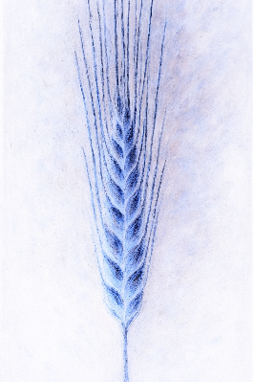
The Syrian barley landrace ;-) ... in a setting where suddenly its allele “A₁” leads to 10% higher number of seed (average for “A₁A₁” individuals; plants are either “A₁A₁” or “A₂A₂”). Assume A₁A₁ types are initially at 50% frequency: p₀(A₁)= 0.5.
A₁A₁ will thus by and by become more frequent than A₂A₂. Following the algebra of compound interest (Zinses-Zins), in the first offspring after the sudden change we find P(A₁A₁) ≈ 52.4% of offspring plants. This follows from 1.1/(1.1+1.0) ≈ 0.524. After further one and two generations, A₁A₁ will make 54.8% then 57.1%. After 69 generations, 99.9% of all plants will be A₁A₁ types.
If initially A1 was a rare mutation, such as 1 in 1 million (p₀(A₁)= 0.000001), then it would take 218 generations to arrive at 99.9% of A₁A₁ types.
It just happens. Selection changes the genetic composition of a population. Change in allele and genotype frequency towards higher fitness due to selection.
It just happens
9

Slide 10
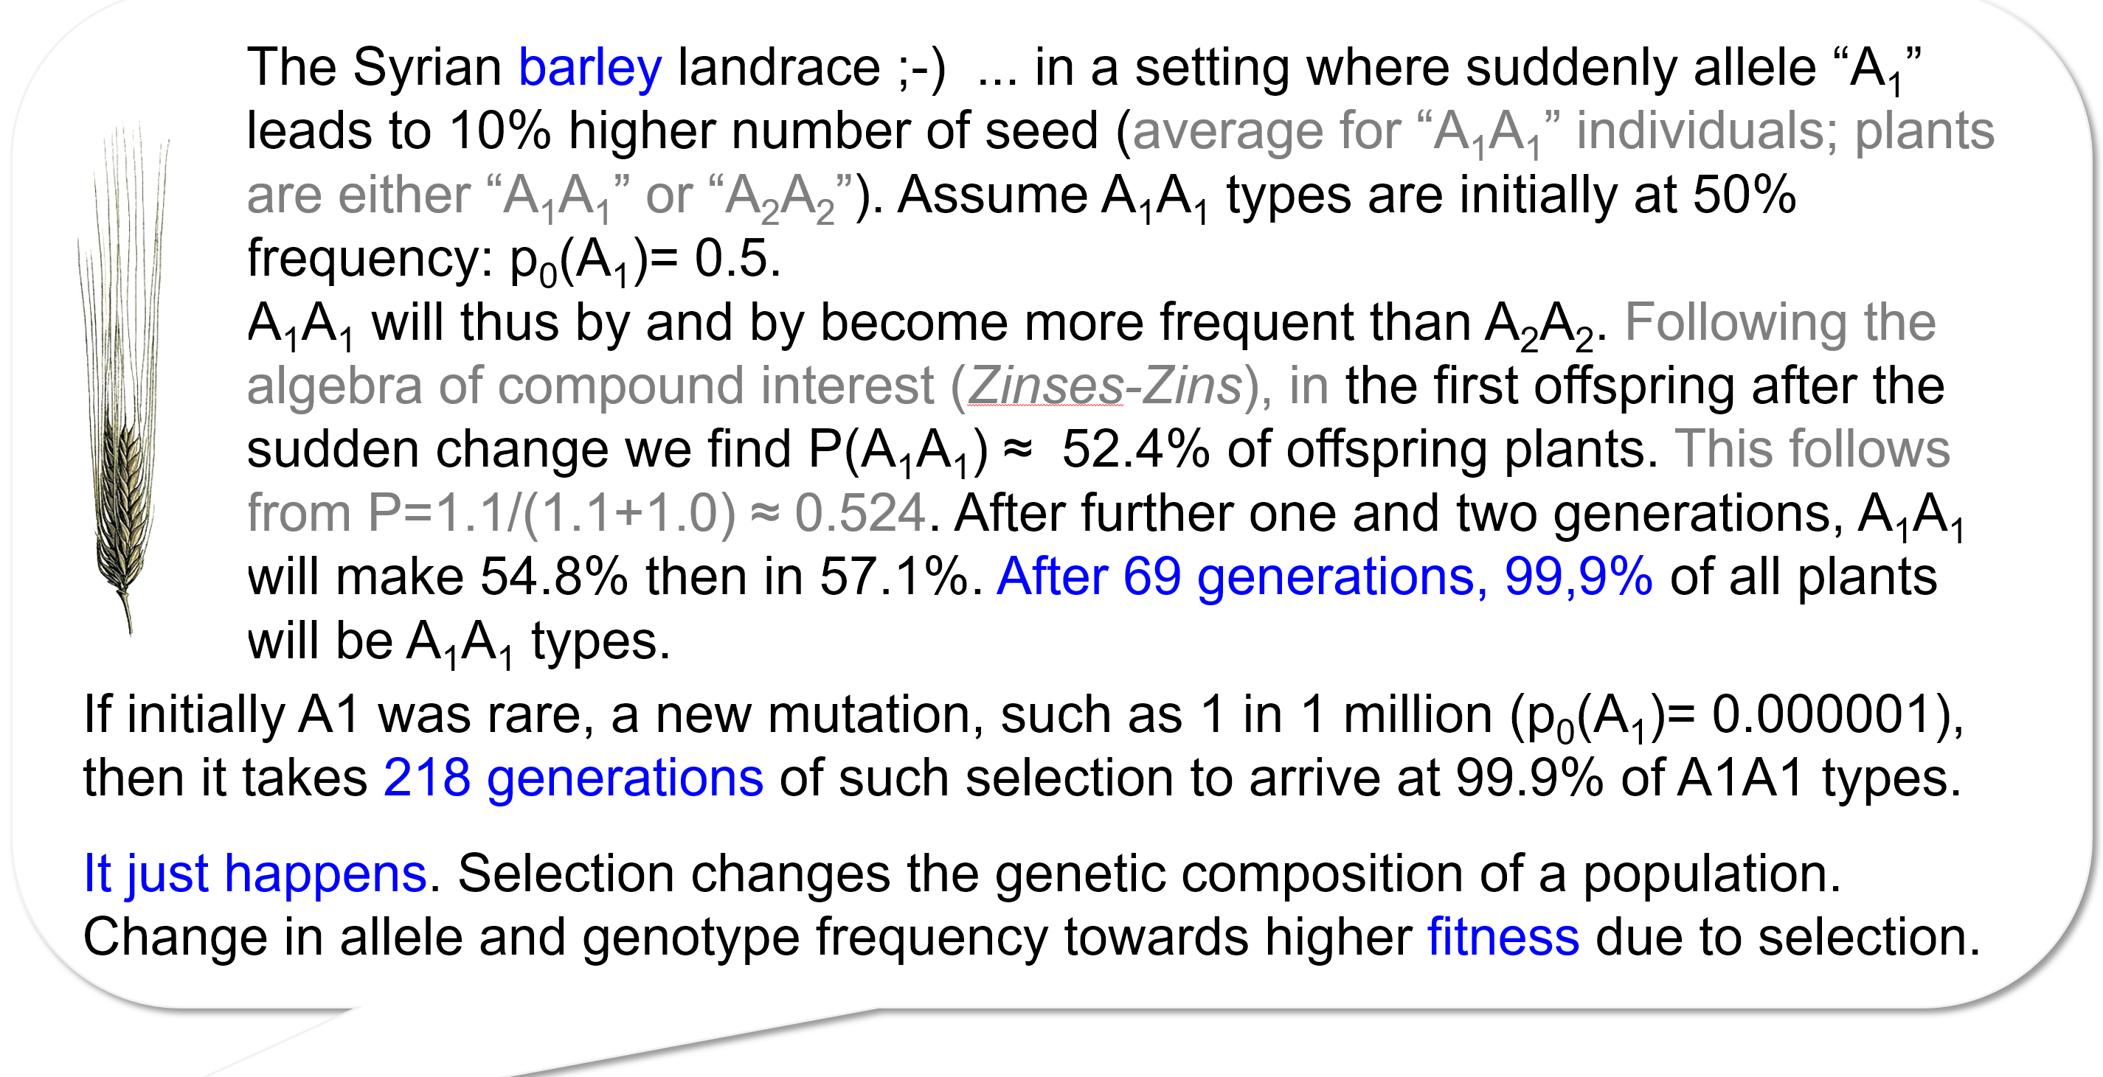
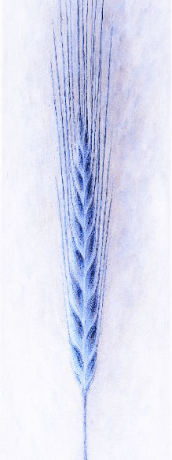
Be careful. Here, the advantage comes as increase, such as 10% higher number of seed. In later algebra, differences will come as dis-advantages versus 1 or versus 100%, as reductions. Watch out for the parameter s = Selection Coefficient (or Coefficient of Selection).
10

Slide 11
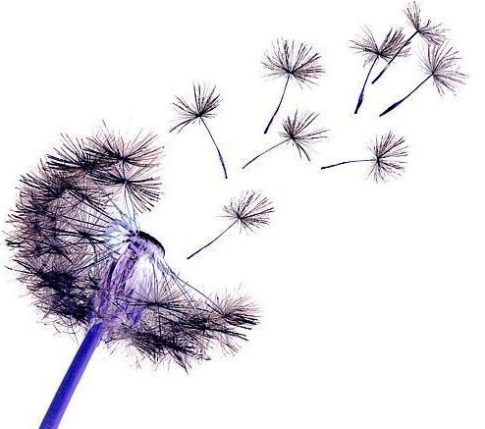
Natural selection implies (1) heritable fitness differences between individuals and (2) high potential of reproduction and limited resources for living (well: for reproduction).
We talk about Selection.
Darwin said: ‘Natural Selection’; ‘Survival of the fittest’.
An important point is: Number of offspring is usually far larger than the number of offspring which ultimately will successfully reproduce, I mean which will be parents of the next generation.
If not all individuals can have offspring, we ask: ‚Who-then will be ancestor of future generations‘ ? We open the discussion about survival-or-not and of hence of natural-selection.
Hm … the point is not ‚survival‘. If an individual survived and, say, lived happily and long, yet had no offspring, then, in our sense here, it did not survive. Well, its kids kind-of died before coming into existence.
The task is obviously not: ‚Survive!‘. For evolution, domestication and breeding, the task is: ‚Have many kids’.
The term is then: “Fitness”. Higher fitness means ‘more offspring’.
11
11

Slide 12
In nature, there is nobody to ‘do’ selection. No intention, no conscious ‘will’ nor motivation, no acting authority. It ‘just’ happens; it happens to happen.
If early flowering – in a given eco-niche of living – increases the probability to escape from a reliable and strong drought stress and thus is a good strategy to live and have offspring … if early flowering increases probability and number of offspring (late flowering causing the contrary), then the alleles coding for late flowering will by and by be diluted and vanish, and the haste-making alleles will become more and more frequent and dominate the future generations. This would be natural selection.
In such case, early flowering would increase the so-called Fitness of a genotype.
Fitness: The contribution a genotype to the next generation, expressed as relative quantity of offspring, mostly relative to the maximal-occurring fitness* in the given population of genotypes.
*genetic value! Not just a good-luck-biased phenotypic value of a single individual. Genes are inherited, not individual good-luck or bad-luck.
12
12

Slide 13
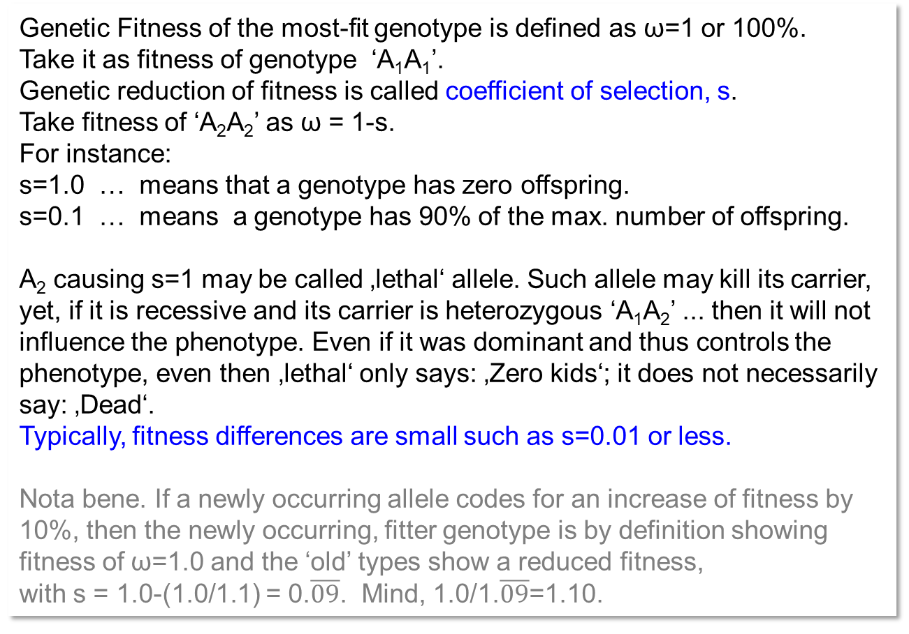
Selection. Fitness is not the result of plants conducting Aerobics or Zumba ;-)
Genetic Fitness of the most-fit genotype is defined as ω=1 or 100%.
Take it as fitness of genotype ‘A₁A₁’.
Genetic reduction of fitness is called coefficient of selection, s.
Take fitness of ‘A₂A₂’ as ω = 1-s.
For instance:
s=1.0 … means that a genotype has zero offspring.
s=0.1 … means a genotype has 90% of the max. number of offspring.
A₂ causing s=1 may be called ‚lethal‘ allele. Such allele may kill its carrier, yet, if it is recessive and its carrier is heterozygous ‘A₁A₂’ ... then it will not influence the phenotype. Even if it was dominant and thus controls the phenotype, even then ‚lethal‘ only says: ‚Zero kids‘; it does not necessarily say: ‚Dead‘.
Typically, fitness differences are small such as s=0.01 or less.
Nota bene. If a newly occurring allele codes for an increase of fitness by 10%, then the newly occurring, fitter genotype is by definition showing fitness of ω=1.0 and the ‘old’ types show a reduced fitness,
with s = 1.0-(1.0/1.1) = 0.$\overline{09}$. Mind, 1.0/1.$\overline{09}$=1.10.
Taraxacum officinale
The parameter s
Coefficient of Selection;
= Selection Coefficient.
13
13

Slide 14
Selection. Fitness is not the result of plants conducting Aerobics or Zumba ;-)
A fitness-reducing allele causes a less-frequent transfer of (copies of ) itself to the next generation; but as well it causes a less-frequent transfer of all genes of its carrier plant to the next generation. Yet, in large popu-lations this allele and all ‚other‘ genes usually occur in all combinations in the many genotypes of the population (low or zero gamete phase dis-equilibrium between loci; more to this later). Therefore, on average, a fitness-changing allele changes only (or mainly) the frequency of being transferred to offspring, the transfer of itself, not of other alleles.
Different to natural selection, in artificial selection the breeder intends to apply s=1 (‚take it or don‘t). This is reality if the plant‘s genotype for said genes is identified (via phenotype for monogenic traits; or via DNA analysis). Typically, the effect of a single, segregating locus on a trait like maize seed oil content is small and blurred by environmental effects and by companion genes (genetic background). Thus, s<<1. Changes in allele frequencies of loci under selection are thus small (slow). This is why genetic progress in agronomic performance is slow & long-lasting, and why seemingly genetic variation is – even after many generations of selection – not (fully) exhausted.
If - say by migration - a new, favourable allele occurs and starts to be selected and to increase its frequency … all alleles which are fully linked to it will increase in frequency as well, hitchhiking … ;-)
14
14

Slide 15
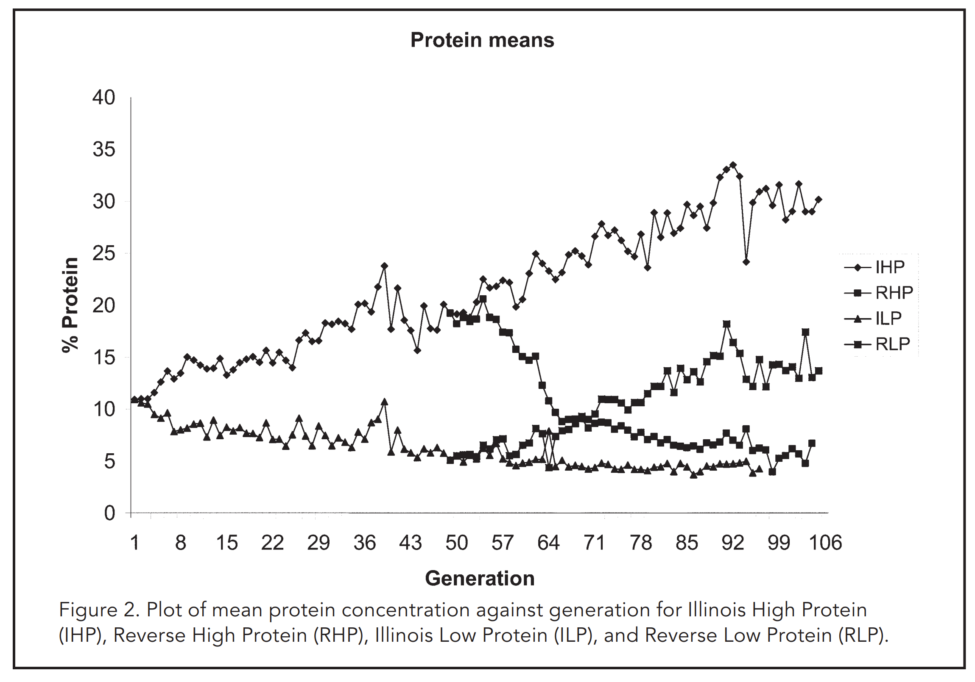
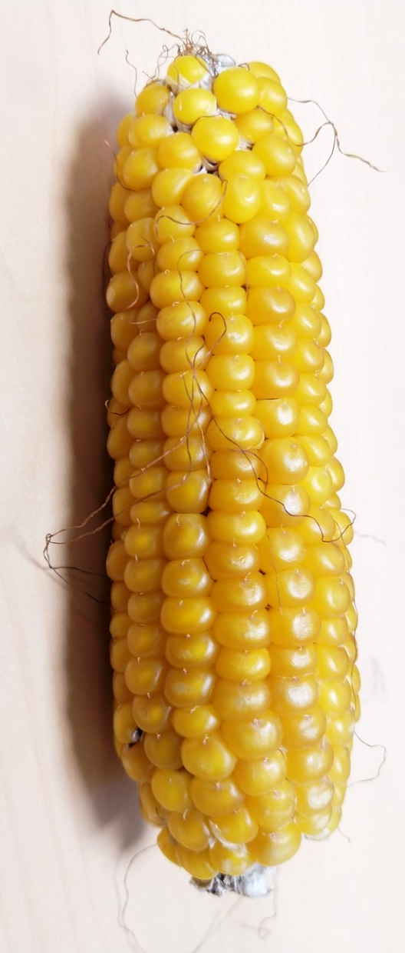
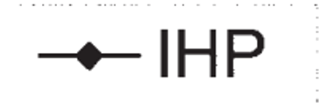
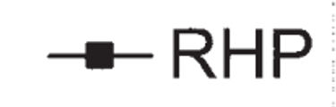
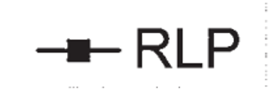
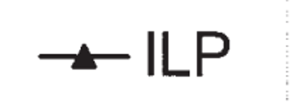
The famous Illinois Maize Long Term Selection experiment
© WL
DOI:10.2135/cropsci2007.04.0003IPBS
http://mooselab.cropsci.illinois.edu/longterm.html
Reverse selections (RHP, RLP) started in gen. 48
Dudley 2007. Plot of mean protein concentration in seeds across generations of selection for High Protein ( ♦ IHP), reverse selection for High Protein (■ RHP), for Low Protein ( ▲ILP) and reverse selection for Low Protein (■ RLP) in the famous Illinois Long Term Selection experiment.
15

Slide 16

The famous Illinois Maize Long Term Selection experiment
Such very long-lasting and (seemingly) endless progress from selection is extremely astonishing!
Obviously, even 48 genera-tions of successful selection did not exhaust genetic diver-sity.
See how ‘fast’ the reverse se-lection worked; in generation ~48, there was still enough ge-netic diversity to fast-reverse the direction of selection!
Part of the explanation is that (1) very many loci contribute to protein content and (2) hence selection coefficients per locus are small and allele frequency changes are small. And, may be, some loci influence the trait only at specific protein% le-vels (epistasis).
DOI:10.2135/cropsci2007.04.0003IPBS
48
I should not write „very many loci contribute to protein content” but “allelic diversity at very many loci contributes to the genetic diversity of protein content” :-)
16
16

Slide 17
Selection for Fitness or for an agronomic trait. Selection coefficient s is usually defined as reduction of Fitness of a genotype, versus the maximum-fit genotype’s fitness.
Invented example (scenario): Impact of a single locus on Fitness, in case of dominant-recessive gene action
Genotypes
AA | Aa | aa
Fitness of AA higher than aa
1 | 1 | 1-s
Fitness of AA lower than aa
1-s | 1-s | 1
Writing ‘A’ versus ‘a’ implies ‘A’ is dominant over ‘a’.
We may assume Random Mating and HWE.
Then, if A is initially a rare allele, selection in favour of A is stronger if the A-coded advantage is as well fully expressed in the heterozygous Aa phenotype and not only in the AA genotype.
If the heterozygous genotype shows an inter-mediate (dis-)advantage, then - as long as the favourable allele is not yet frequent - the selection-induced allele frequency changes are smaller and change occurs slower across the generation scale (time scale) than in dominant-recessive type of gene action.
All the many other genes (most of them segregating in the population) have zero impact on ‚Fitness‘: This here is a pure mono-genic setting. The heterozygous genotype Aa shows exactly the same Fitness as the homozygous AA genotype, and their Fitness is higher than in case of genotypes aa. The environmental conditions are stable and steady, the Selection coefficient s is constant across all generations.
Anyway: No Mutation, no Migration, no Drift. The reproductive mode may be Random Mating (but it could be Self-Fertilization or Mixed Mating or Vegetative Propagation). Just to describe s and gene action, this need not yet be fixed.
But, the reproductive mode is of course stable, unchanged.
Impact of single locus on fitness, case of intermediate gene action
Genotypes
A₁A₁ | A₁A₂ | A₂A₂
Fitness of A₁A₁ higher than A₂A₂
1 | 1 - 0.5s | 1-s
Fitness of A₁A₁ lower than A₂A₂
1-s | 1 - 0.5s | 1
17
17

Slide 18
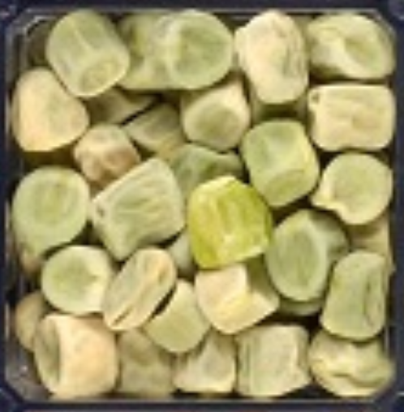
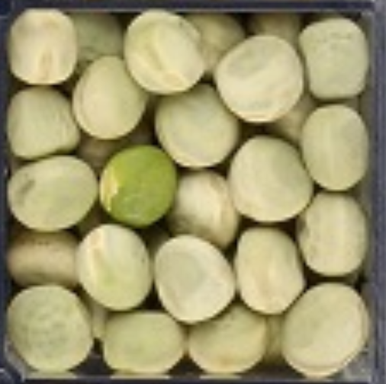
Selection for Fitness or for an agronomic trait. Selection coefficient s is usually defined as reduction of Fitness of a genotype, versus the maximum-fit genotype.
Impact of a single locus on fitness, in case of dominant-recessive gene action
Genotypes
AA | Aa | aa
Fitness of AA higher than aa
1 | 1 | 1-s
Fitness of AA lower than aa
1-s | 1-s | 1
A reminder: Recessive, Dominant: Gene action.
Pea means self-fertilization ;-) … Wrinkled is recessive. A monogenic Mendelian trait. Wrinkled may reduce seed longevity (fitness?).
https://d-nb.info/840248164
DOI 10.1079/9780851996530.0041
Wrinkled
Un-wrinkled, round
Impact of single locus on fitness, case of intermediate gene action
Genotypes
A₁A₁ | A₁A₂ | A₂A₂
Fitness of A₁A₁ higher than A₂A₂
1 | 1 - 0.5s | 1-s
Fitness of A₁A₁ lower than A₂A₂
1-s | 1 - 0.5s | 1
https://doi.org/10.3390/ijms18061205
Starch-branching enzyme gene (‘wrinkled’) muta-tion, genetic locus r, located on long arm of chro-mosome 3 of Pisum sativum.
18
18

Slide 19
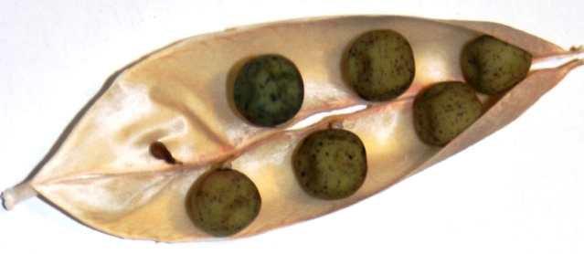

Allele frequency changes due to Selection. Self-fertilizing (homozygous) population.
Case: Selfing
s=0.5 => fitness ω(aa)=1-0.5 = 1/2
E.g. in generation 10. we arrive at q(a)=0.494.
(Genotypes, Fitness)
P(AA)=0.506;(Aa)=0; Q(aa)=0.494
1 - 1/2
Generation 10 produces gametes:
AA►0.506/(0.506+0.494/2) A-gametes.
= 0.672 A-gametes
aa ►(0.494/2)/(0.506+0.494/2) a-gametes.
= 0.328 a-gametes
Hence, the ratio of AA and aa in generation 11:
P(AA) = p(A) = 0.672
Q(aa) = q(a) = 0.328.
|Δq=0.494-0.328=0.166|
Initial frequency q(a) = 0.999
1.0
0.9
0.8
Selfing, s=0.5
0.7
Algebra:
Per one step of Selection
Change in q(a) is Δq
$$Δq= −pq \frac{s}{1−sq}$$
0.6
Frequency of 'a‘ = Frequency of ‘aa’
0.5
0.4
0.3
0.2
0.1
© Urbatzka
0.0
0
5
10
15
20
25
30
35
40
45
50
Generations under constant selection against 'a'
Do not think that ‘Selfing’ means that the entire story starts with F1 or the like. Think that this Selection story
starts after this Population was already homozygous (yet heterogeneous) since long. See page 8, ‘landrace’.
19

Slide 20
Allele frequency changes because of Selection; different ‘cases’. First case: Selfing.
Initial frequency q(a) = 0.999
Enjoy the animation
1.0
0.9
0.8
Selfing, s=0.5
0.7
0.6
Frequency of unfavourable allele 'a'
0.5
0.4
0.3
0.2
0.1
0.0
0
5
10
15
20
25
30
35
40
45
50
Generations under constant selection against 'a'
20

Slide 21
Allele frequency changes because of Selection; different ‘cases’. First case: Selfing.
Initial frequency q(a) = 0.999
Case: Selfing, s=0.5
With s=0.5, this means with a heavy dis-advantage for allele ‘a‘ and with anyway all genotypes being homozygous, the frequency of ‘a’ is reduced quite fast and reaches zero about in generation 20. Even with relatively large populations, it reaches ‘really’ zero. Change (so-to-say ‘drop’) is fastest and steepest at interme-diate areas of allele frequency, near to p(a)=0.5.
If s=0.1, the pattern is the same just slower. In about 50 generations that little change of p(a) happens with s=0.1 that happened with s=1.0 already in about 8 generations.
1.0
0.9
Selfing, s=0.1
0.8
Selfing, s=0.5
0.7
0.6
Frequency of unfavourable allele 'a'
0.5
0.4
0.3
0.2
0.1
0.0
0
5
8
10
15
20
25
30
35
40
45
50
Generations under constant selection against 'a'
21

Slide 22
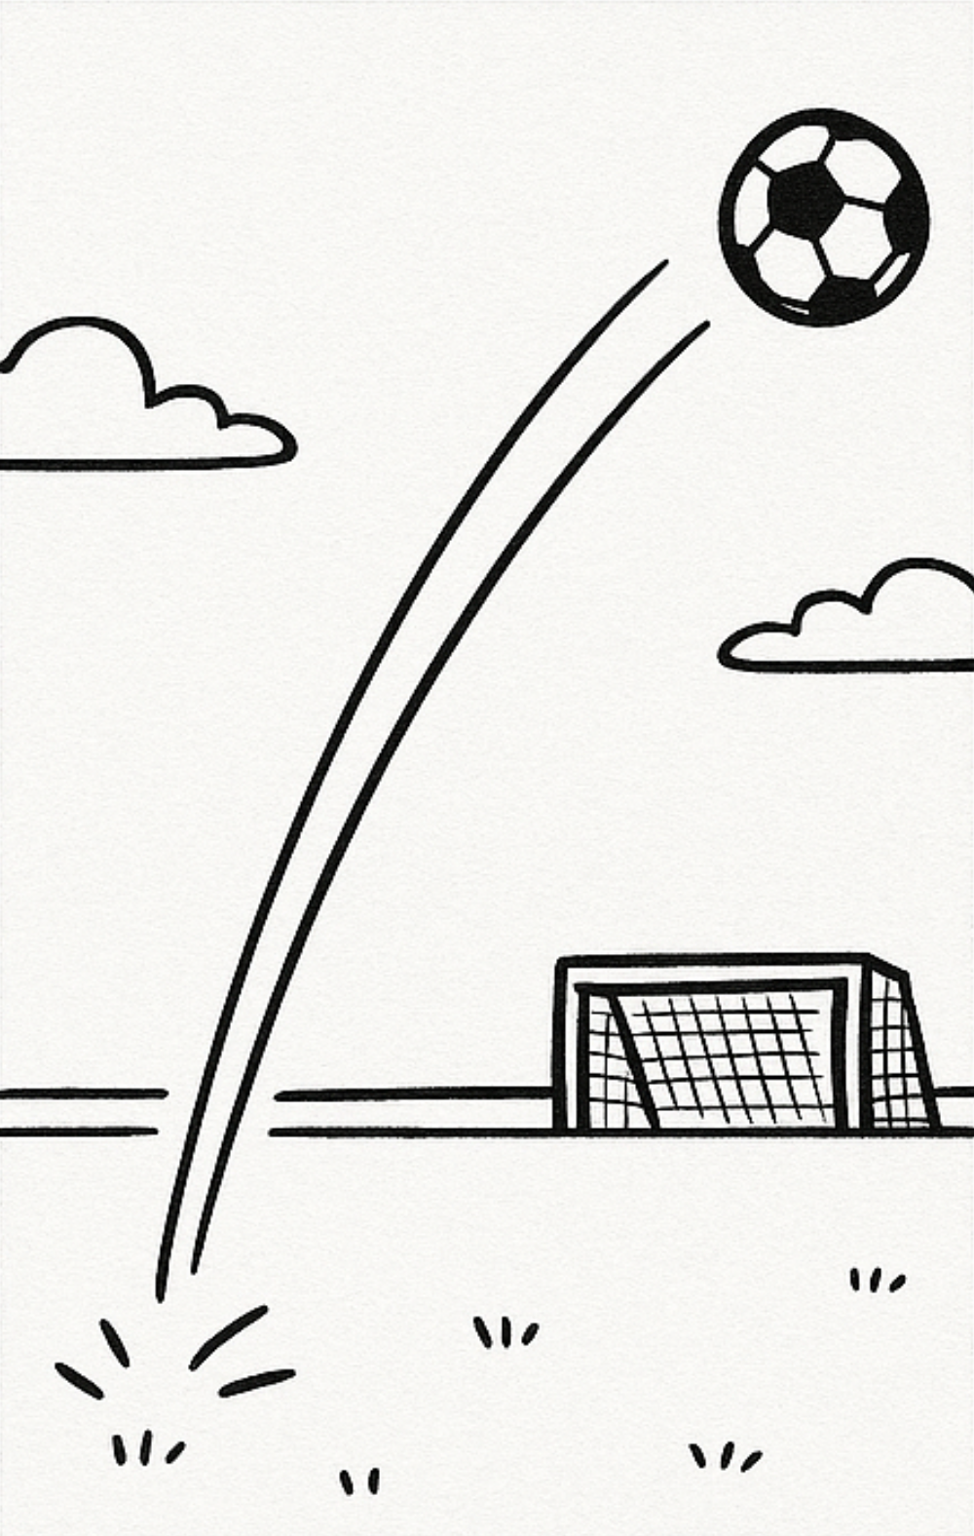
Allele frequency changes because of selection, different ‘cases’. Random Mating.
Case: Coefficient of selection s=0.5
If Aa phenotypically indeed shows a mar-ked disadvantage versus AA (e.g. case of intermediate gene action) ... then Selection in favour of A is initially slower than if ‘a’ is fully recessive. At initially very low frequen-cies of AA genotypes … P(AA)=[p(A)]² is very rare then … the allele ‘A’ exists mainly in ‘Aa’ heterozygous types (with their only half-size advantage compared to ‘aa’).
Yet, finally, selection can kick out ‚a‘ be-cause ‘a’ can – intermediate gene action – not fully hide ‘under’ A and is even purged if occurring in Aa genotypes.
Mind: If e.g. p(a)=1%, then in HWE only 1 in 10 000 individuals is ‚aa‘ whereas 198 in 10 000 individuals are ‚Aa‘. q²<<2pq
Initial frequency q(a) = 0.999
1.0
0.9
0.8
Selfing, s=0.5
0.7
Random mating, s=0.5, intermediate
0.6
Attention.
Now, with Random Mating, 2pq heterozygotes occur!
Frequency of unfavourable allele 'a'
0.5
0.4
0.3
0.2
0.1
0.0
0
5
10
15
20
25
30
35
40
45
50
Generations under constant selection against 'a'
Square of rare is very rare!
22

Slide 23
Allele frequency changes because of selection, different ‘cases.’ Random Mating.
Case: Random mating, s=0.5, dominant-recessive gene action between A and a.
With s=0.5 and random mating, it makes a huge difference whether the disadvantage is recessive or intermediate.
If Aa genotypes do not show the disad-vantage of allele ‘a’, then the increase of ‘A’ (=decrease of ‘a’) is initially faster than if Aa genotypes do experience the disad-vantage of ‚a‘.
Later, at low frequencies of ‚a‘, with Q(aa)=[q(a]² being very small numbers, and if ‚a‘ is recessive: Then selection can barely act any more against it. Therefore, this unfavourable allele ‘a’ stays very long* at low frequencies.
*Genetic load. Many recessive, ‚bad‘ alleles exist in HWE at low frequencies without doing much phenotypic harm – unless inbreeding ‘uncovers’ them.
Initial frequency q(a) = 0.999
1.0
0.9
0.8
Random mating, s=0.5, dominant
0.7
Random mating, s=0.5, intermediate
0.6
Selfing, s=0.5
Frequency of unfavourable allele 'a'
0.5
0.4
0.3
0.2
0.1
0.0
0
5
10
15
20
25
30
35
40
45
50
Generations under constant selection against 'a'
23

Slide 24
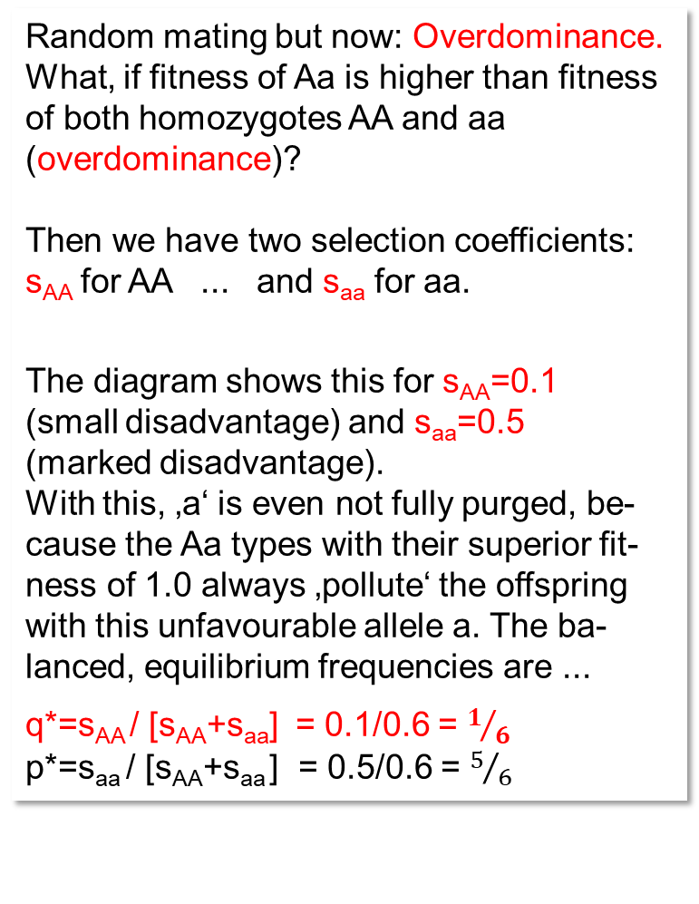
Overdominance (heterozygous genotype is fittest; here in case of Random Mating)
Initial frequency q(a) = 0.999
Random mating but now: Overdominance.
What, if fitness of Aa is higher than fitness of both homozygotes AA and aa (overdominance)?
Then we have two selection coefficients:
s_{AA} for AA ... and s_{aa} for aa.
The diagram shows this for s_{AA}=0.1
(small disadvantage) and s_{aa}=0.5
(marked disadvantage).
With this, ‚a‘ is even not fully purged, be-cause the Aa types with their superior fit-ness of 1.0 always ‚pollute‘ the offspring with this unfavourable allele a. The ba-lanced, equilibrium frequencies are ...
q*=s_{AA} / [s_{AA}+s_{aa}] = 0.1/0.6 = $1/6$
p*=s_{aa} / [s_{AA}+s_{aa} ] = 0.5/0.6 = $5/6$
1.0
0.9
0.8
Selfing, s=0.5
Random mating, s=0.5, dominant
0.7
Random mating, s=0.5, intermediate
0.6
Selfing, s=0.5
Random mating, s_{AA}=0.1, s_{aa}=0.5
Frequency of unfavourable allele 'a'
0.5
0.4
0.3
0.2
0.1
0.0
0
5
10
15
20
25
30
35
40
45
50
Generations under constant selection against 'a'
By the way: The average fitness of the population is highest at the equilibrium, at q=q* and q=p*
24

Slide 25
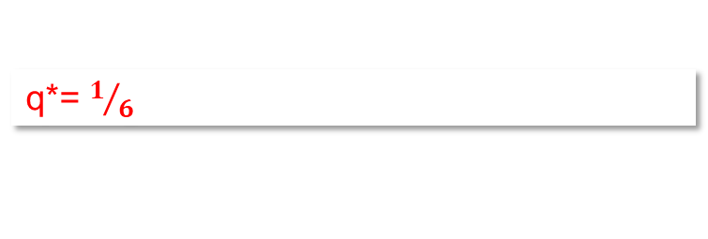
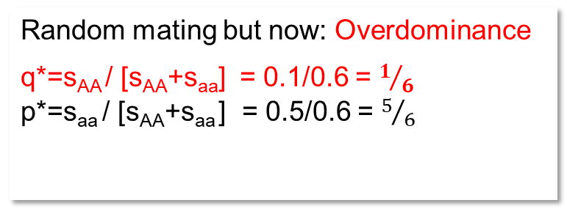
Overdominance (Random Mating). Selection changes p(A) and q(a) until equilibrium.
Initial frequency q(a) = 0.999
Random mating but now: Overdominance
q*=s_{AA} / [s_{AA}+s_{aa}] = 0.1/0.6 = $1/6$
p*=s_{aa} / [s_{AA}+s_{aa} ] = 0.5/0.6 = $5/6$
1.0
0.9
0.8
Selfing, s=0.5
Random mating, s=0.5, dominant
0.7
Random mating, s=0.5, intermediate
0.6
Selfing, s=0.1
Random mating, s_{AA}=0.1, s_{aa}=0.5
Frequency of unfavourable allele 'a'
0.5
0.4
0.3
0.2
q*= $1/6$
0.1
Even if the start was at q(a)<1/6, then q* would still be the same
0.0
0
5
10
15
20
25
30
35
40
45
50
Generations under constant selection against 'a'
Again: The average fitness of the population is highest at the equilibrium, at q=q* and q=p*
25

Slide 26
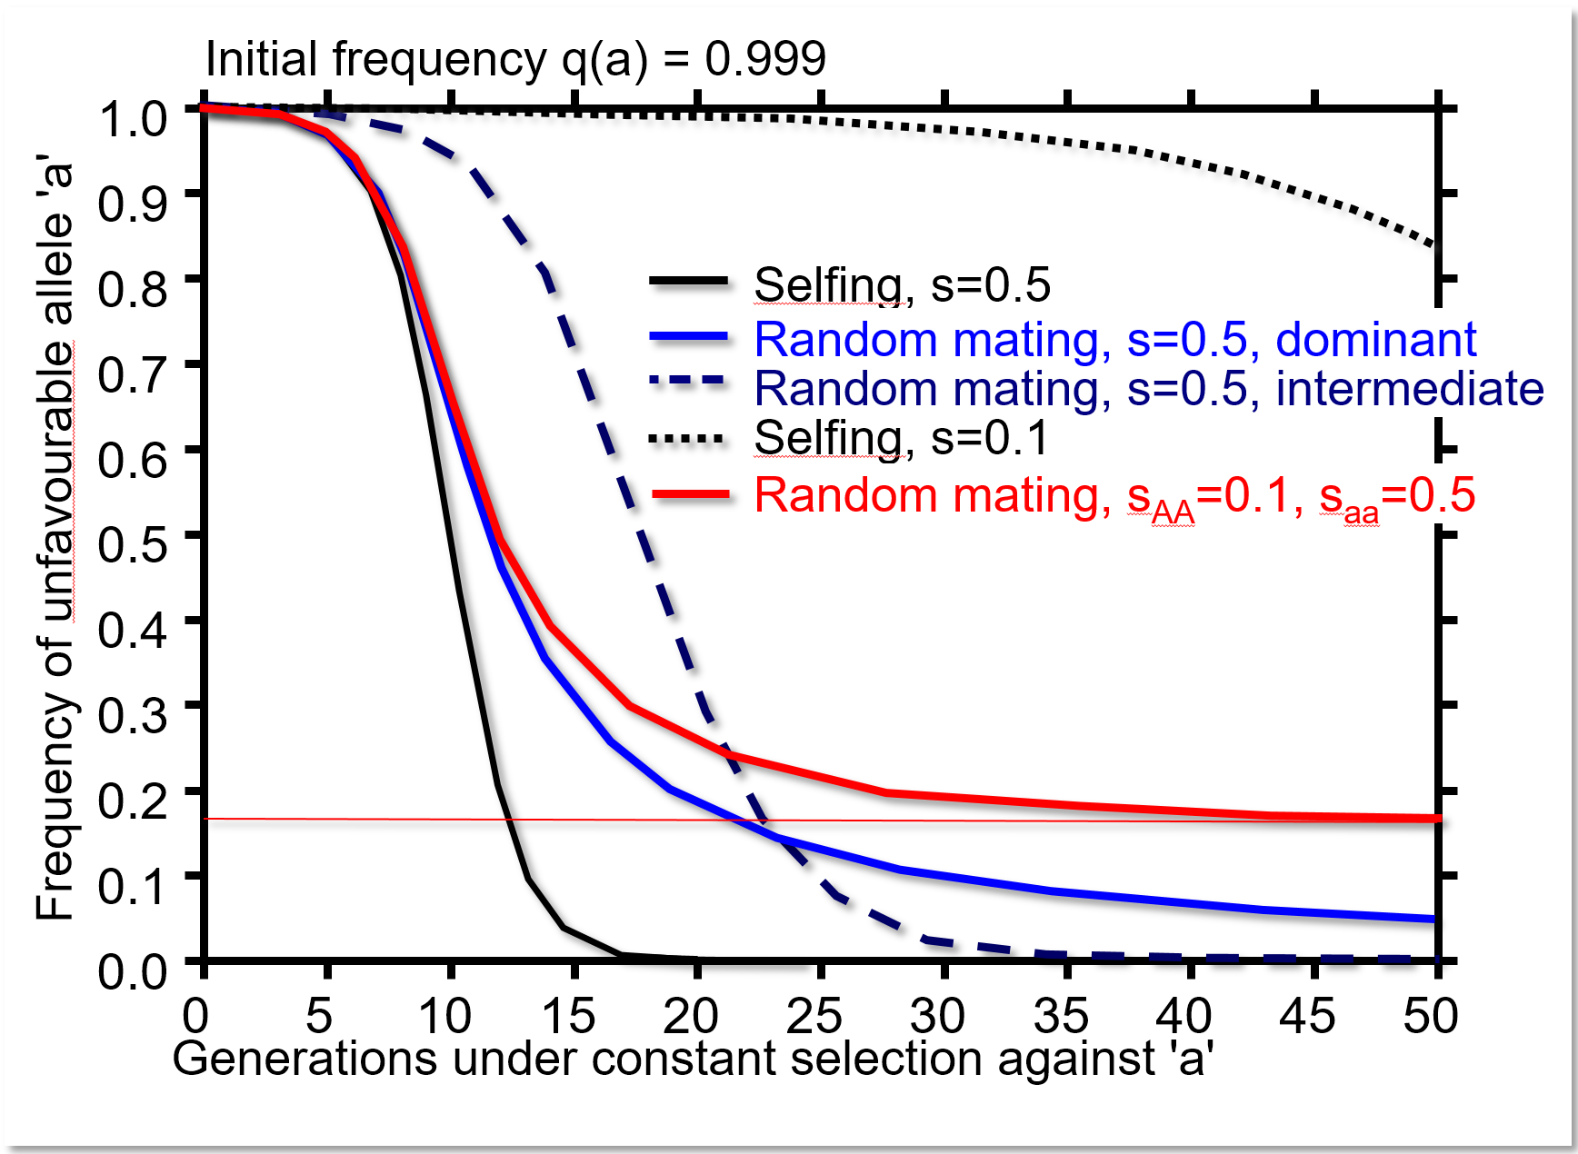
These ‚drop-down curves‘ … as they show the decrease in frequency of the unfavourable allele, implicitly show the increase in frequency of the favourable allele (only two alleles in our simple-way of thinking).
The drop of the curves is more or less steep; and is steep at smaller or at larger allele frequencies; and partly this depends on the quantity of s.
The selection coefficient s, as shown here (s=0.5 or s=0.1), is probably very rarely that large and probably is very small in nature and in phenotype-based selection, at least if we talk about polygenic traits (yield and
the like).
I was curious: What is the allele frequency
that causes the (relatively) largest, fastest
change in allele frequency - Δq(a) - if s was
very small?
overdominance
26
26

Slide 27
From here you may go to UNPLAB-PopGen_Ch-7[Δq]
27
27

